Slide 1
AI Project
Robert Scollon
Nicholas Horsman
Anthony Kniazewycz
Leonard Garrison

Slide 2
Initial changes with basic ability to turn vacuum off:
Agent | Bugs captured | Bugs escaped | Success ratio
Learner one | 63 | 57 | 0.525
Our agent | 171 | 142 | 0.546

Slide 3
New changes with rewards:
Agent | Bugs captured | Bugs escaped | Success ratio
Learner one | 63 | 57 | 0.525
Our agent | 171 | 142 | 0.546
Our agent w/ rewards | 275 | 47 | 0.859

Slide 4
Tiebreaking
From two equivalent states, prioritize current
Q-learning
Waiting to reward based on previous state

Slide 5
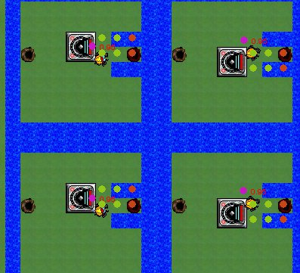
Directed reasoning
Cell contents code
Generate other state vectors
Pick best
Better state representations
Which types of bug
Which directions

Slide 6
Any questions?

